Slide 1

Human Activity Recognition using TENG Sensors

Slide 2
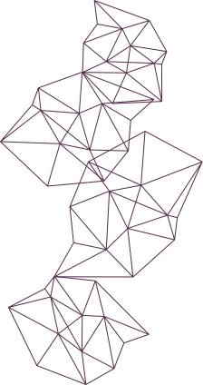
Introduction
01
02
How TENG can convert mechanical motion into electric signals
What is TENG?
Triboelectric Nanogenerators (TENGs) are devices that generate electricity from physical motion. They work by using materials that become electrically charged when rubbed or pressed together. This charge can then be harvested as a voltage signal, making TENGs ideal for energy-harvesting applications.
When two materials in a TENG sensor come into contact and separate during body movements—like walking or running—they generate a small voltage due to the triboelectric effect. This voltage signal reflects the intensity, speed, and type of motion, which can be recorded and analyzed to understand specific human activities
03
Activity classification without traditional sensors or batteries
Most wearable devices rely on batteries and electronic sensors that need regular maintenance and power. TENGs provide a self-powered solution—no batteries, no external power. This enables long-term, low-cost human activity monitoring that’s especially useful in health, fitness, and smart environments.

Slide 3
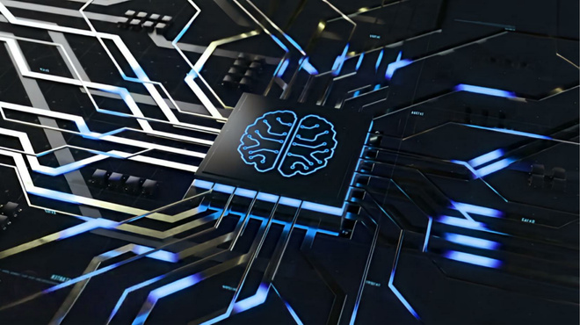
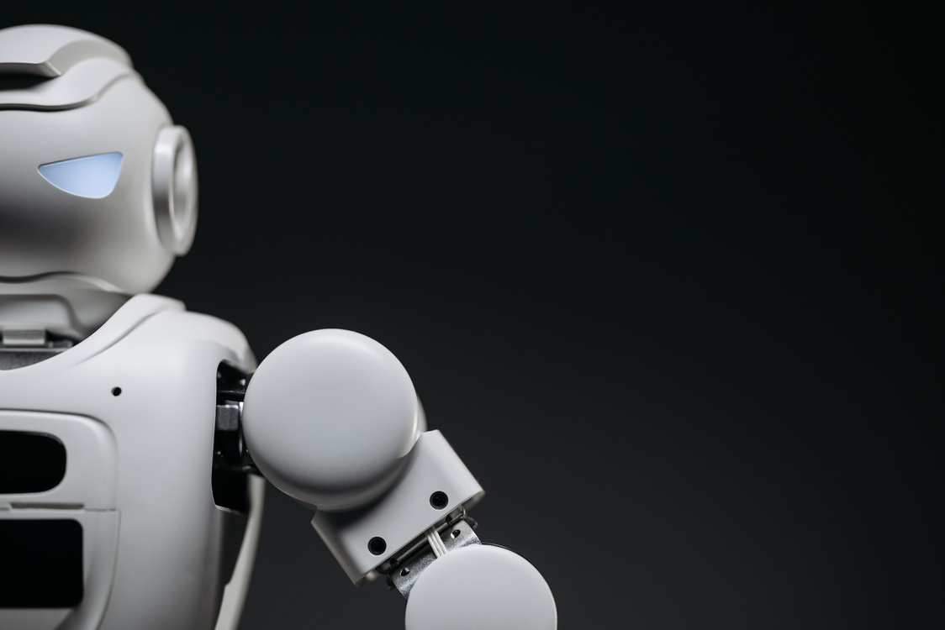
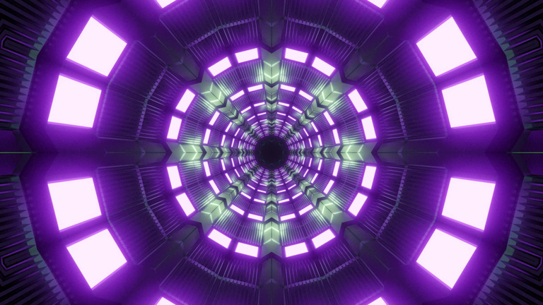
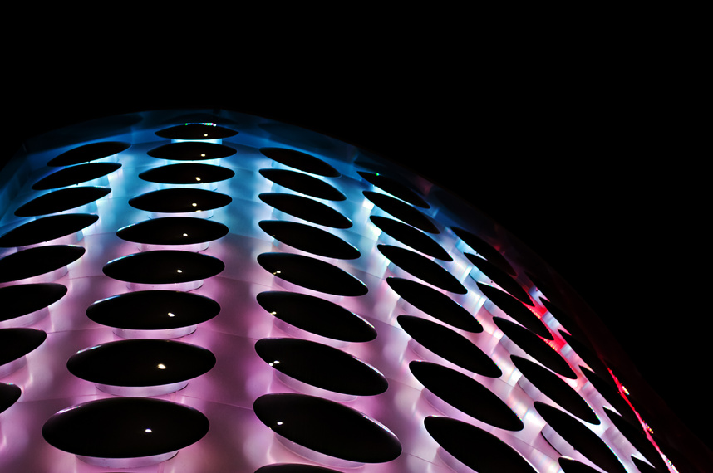
Problem & Motivation
Power Dependency of Traditional Sensors
Bulky and Intrusive Hardware
Need for Energy-Efficient, Always-On Solutions
TENG: A Self-Powered, Signal-Rich Alternative
Most motion-tracking systems today use accelerometers or gyroscopes that require constant power from batteries. This limits their long-term use and demands regular charging or replacement, especially in wearable or remote settings.
Conventional systems often involve multiple sensors and wires, making them uncomfortable for users. Their size and design can interfere with natural movement, reducing practicality for daily wear or elderly monitoring.
There’s growing demand for systems that can continuously monitor activity without needing to recharge. In health care or smart homes, especially, it’s vital to have always-on, low-maintenance solutions that work passively.
Triboelectric Nanogenerators (TENGs) generate voltage from body motion without any power supply. Each motion produces distinct voltage signals—rich with biomechanical information—making them ideal for recognizing human activities accurately and sustainably.

Slide 4
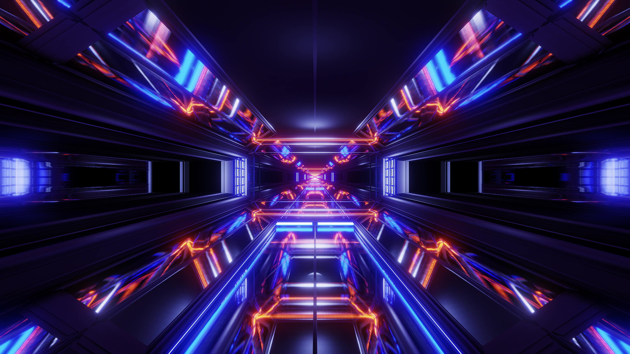
System Overview
&
Data Collection
01
02
03
System workflow
Interactive Simulations
Data Collection
Human Activity
↓
TENG Device
↓
Voltage Signal
↓
Feature Extraction
↓
Classifier
When a person performs a human activity like walking or jumping, the TENG device worn on the body detects the mechanical motion and converts it into an electrical voltage signal. This raw voltage signal is then processed through feature extraction, where important characteristics—such as peaks, duration, and signal patterns—are identified. Finally, these extracted features are fed into a classifier, a machine learning model that analyzes the data to recognize and categorize the specific activity being performed.
Sensors are strategically placed on key body joints such as the wrist and knee to capture motion during various activities like walking, standing, and jumping. As the person moves, the TENG sensors generate voltage signals that are recorded along with precise timestamps, creating detailed data reflecting the unique electrical patterns of each activity.

Slide 5
Feature Extraction (From raw voltage signals)
01
Statistical: Mean, Std, Skewness
02
Temporal: Duration, Signal Rate
Statistical features like mean, standard deviation, and skewness summarize the overall distribution of the voltage signals, capturing the average levels, variability, and asymmetry in the data.
Temporal features such as duration and signal rate describe the timing aspects of the signal, including how long the activity lasts and the speed or frequency at which voltage changes occur.
03
Signal-based: Peak count, RMS, Energy
Signal-based features like peak count, root mean square (RMS), and energy analyze specific characteristics of the waveform itself, measuring how many significant peaks appear, the overall signal strength, and the total power contained in the voltage signal during the activity.

Slide 6
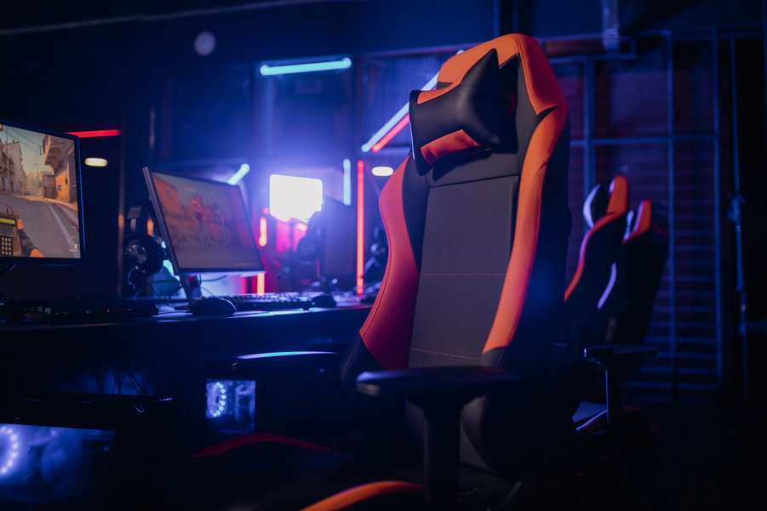
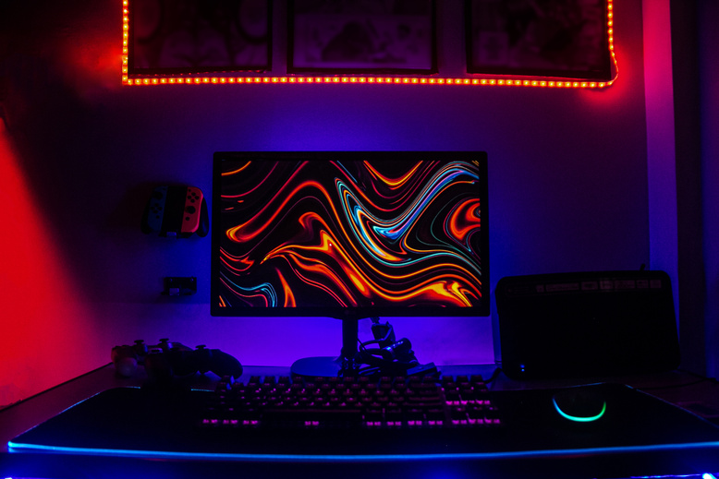
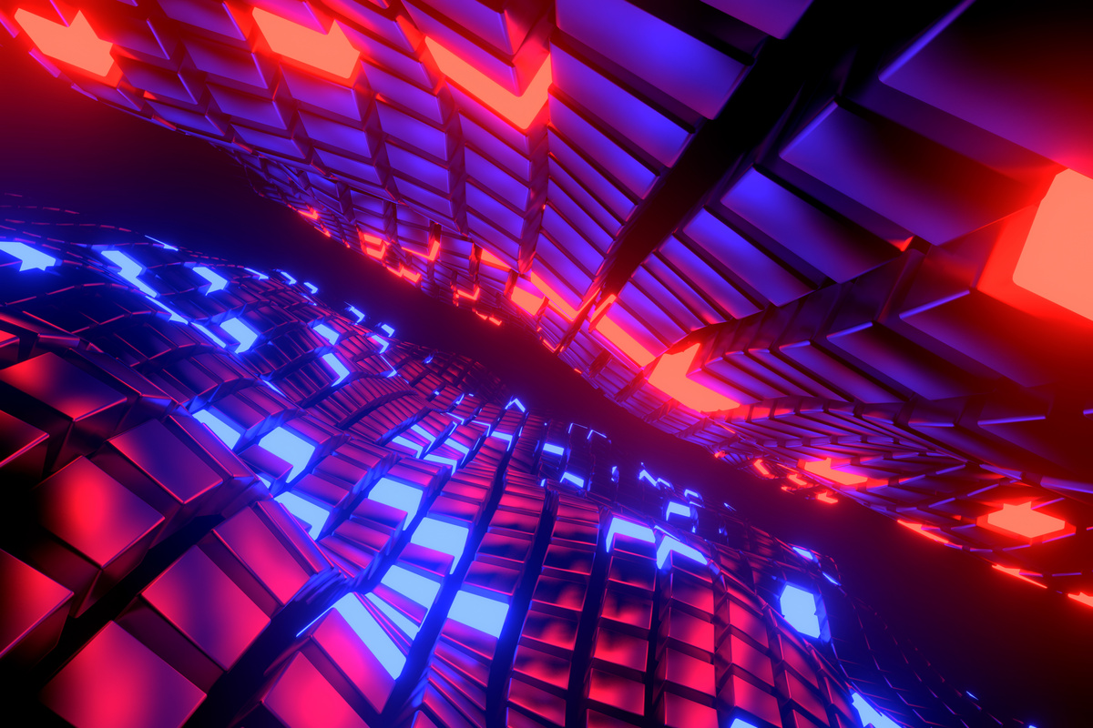
Classification Algorithm
ML Model used
Trained on extracted features
Input: voltage signal; Output: activity class (e.g., walking, running)
We utilize ensemble methods such as Random Forest and XGBoost for classification due to their interpretability and efficiency on structured features.
Our model processes voltage signals using two window sizes:
100-point windows capture fine, short-term voltage dynamics (e.g., spike frequency) crucial for detecting Running.
500-point windows capture broader, long-term patterns (e.g., total energy), essential for distinguishing activities like Jumping.
The pipeline accepts fused multi-resolution features, performs classification in real-time, and is optimized for low-power edge deployment.

Slide 7
Results
01
02
03
Activities correctly recognized and confusion details
Results
Confusion Matrix
Leave-One-Subject-Out (LOSO) validation ensures the model generalizes to unseen users by training on two subjects and testing on the third.
Our pipeline achieves 100% accuracy across all LOSO folds, demonstrating strong subject-independent performance.
| | Predicted W | Predicted R | Predicted J |
| -------- | ----------- | ----------- | ----------- |
| Actual W | 9 | 0 | 0 |
| Actual R | 0 | 9 | 0 |
| Actual J | 0 | 0 | 9 |
Jumping generates the highest energy signals due to intense impact and movement.
Walking produces low, consistent energy levels.
Running exhibits intermediate and variable energy, reflecting dynamic motion.
This matrix confirms that the model can clearly separate signal patterns for each movement type using engineered features (energy, shape, time/frequency domain). It shows no confusion between similar motions like running and jumping, thanks to energy-based insights and window fusion.

Slide 8
Advantages
01
Self-powered operation
02
Lightweight and wearable
The TENG sensor harvests biomechanical energy directly from human motion, eliminating the need for batteries or external power. This makes the system highly energy-efficient and ideal for long-term, wearable use.
The sensor setup is compact and non-intrusive. It can be easily attached to joints like the wrist or knee without affecting natural movement, making it suitable for everyday usage and continuous monitoring.
03
Cost-effective and scalable
04
High classification accuracy
The materials and design of TENG sensors are low-cost and simple to manufacture. This enables scalable deployment across many users or devices, especially in healthcare or fitness environments.
By combining 100-point and 500-point signal segments and using well-engineered features, the system achieves strong accuracy in recognizing activities like walking, running, and jumping—even across different users (100% LOSO accuracy in testing).

Slide 9
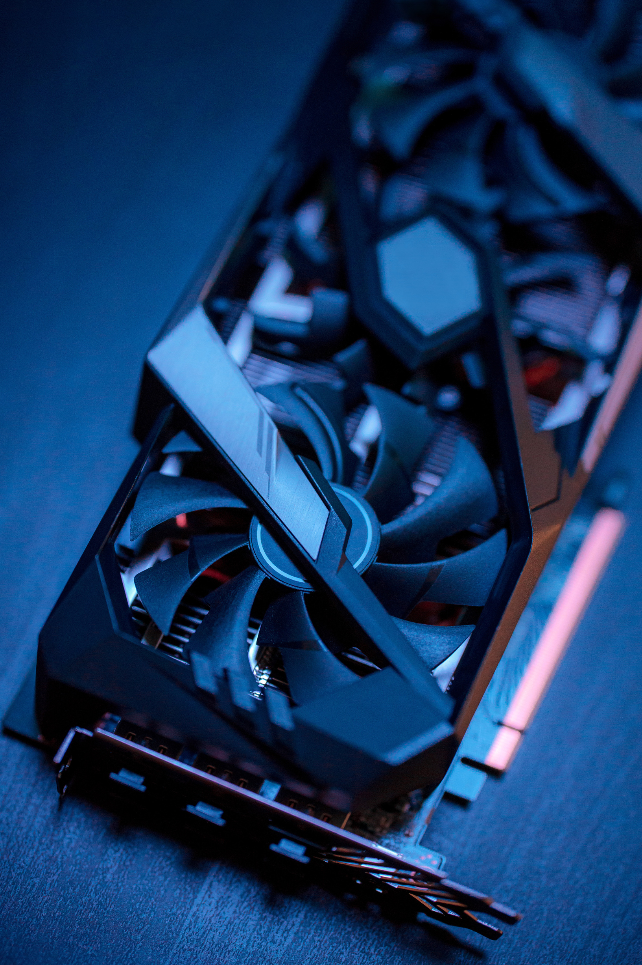
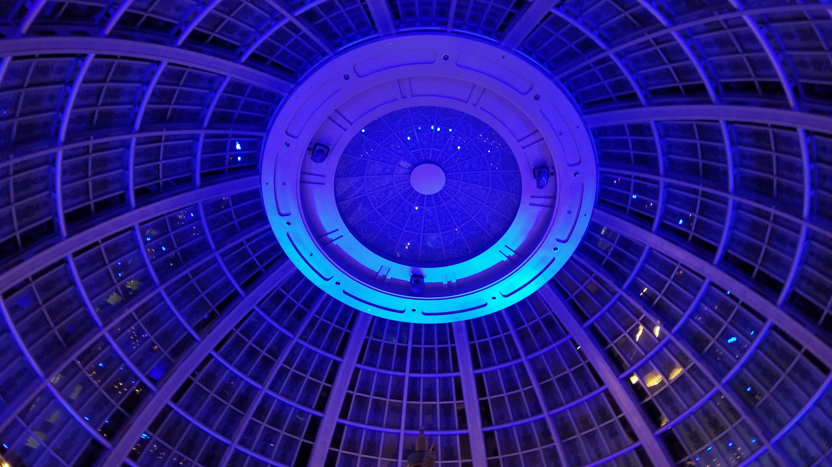
Real-World Applications
Health & Fitness Focus
Industrial & Safety Use
TENG-based activity recognition systems are ideal for smart health monitoring, where lightweight, wearable sensors can track physical motion in real time without external power. In elderly fall detection, sudden voltage spikes from unintentional movements can be instantly classified, enabling immediate alerts. In fitness and sports, athletes' movements can be tracked and analyzed through signal patterns to optimize performance and prevent injury.
In industrial settings, wearable TENG sensors can monitor workers’ physical activities, helping detect abnormal or hazardous movements that may lead to injury or fatigue. This enhances occupational safety while avoiding bulky sensor equipment. The system's self-powered nature and high accuracy make it perfect for continuous deployment in rugged environments.

Slide 10
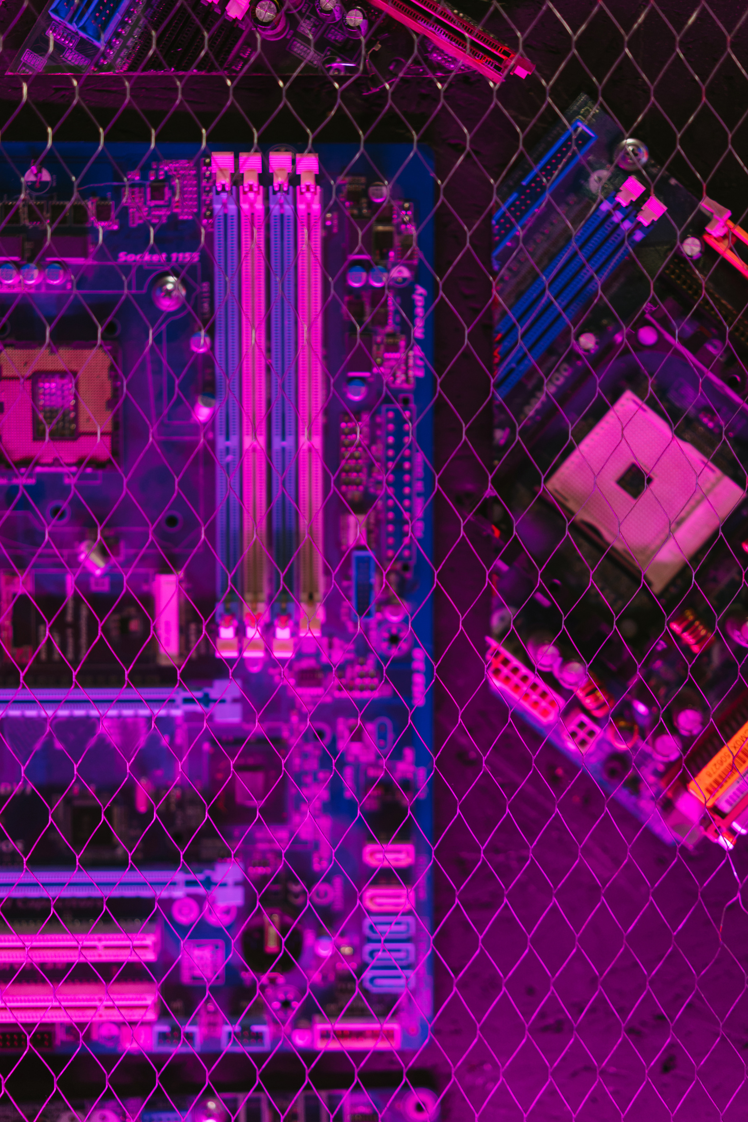
Conclusion
TENG-based activity recognition systems demonstrate strong potential as a sustainable, low-power solution for human motion classification. By converting biomechanical energy into voltage signals, they eliminate the need for batteries or external power. Our project confirms that accurate activity recognition is achievable using lightweight, wearable TENG sensors, paving the way for practical, battery-free applications in health, fitness, and safety.

Slide 11
Q&A

Slide 12
Thank you for your
attention

